Slide 1


Amazon Sales Analysis
Subtitle: SQL Capstone Project
Name: Pravin Paradkar

Slide 2

Content
Project Objective
Dataset Overview
Project Workflow
Data Wrangling
Feature Engineering
Exploratory Data Analysis
Analysis Categories
Insights Summary
Conclusion & Recommendations
Tools Used

Slide 3



Project Objective
Analyze Amazon’s sales data to identify key factors driving performance across branches.
Discover sales trends and analyze customer buying behavior
Identify trends in buying patterns, top-performing products, and revenue growth

Slide 4
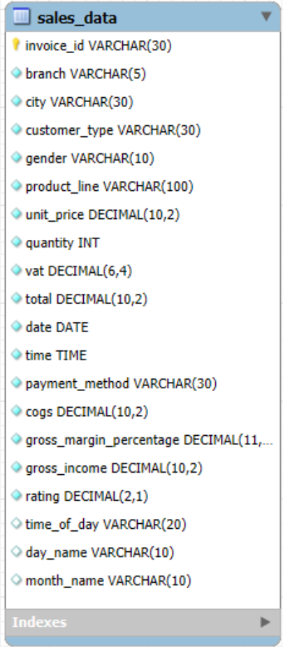
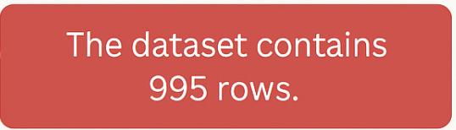
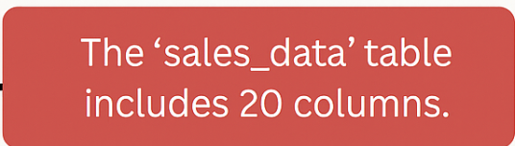
Dataset Overview

Slide 5
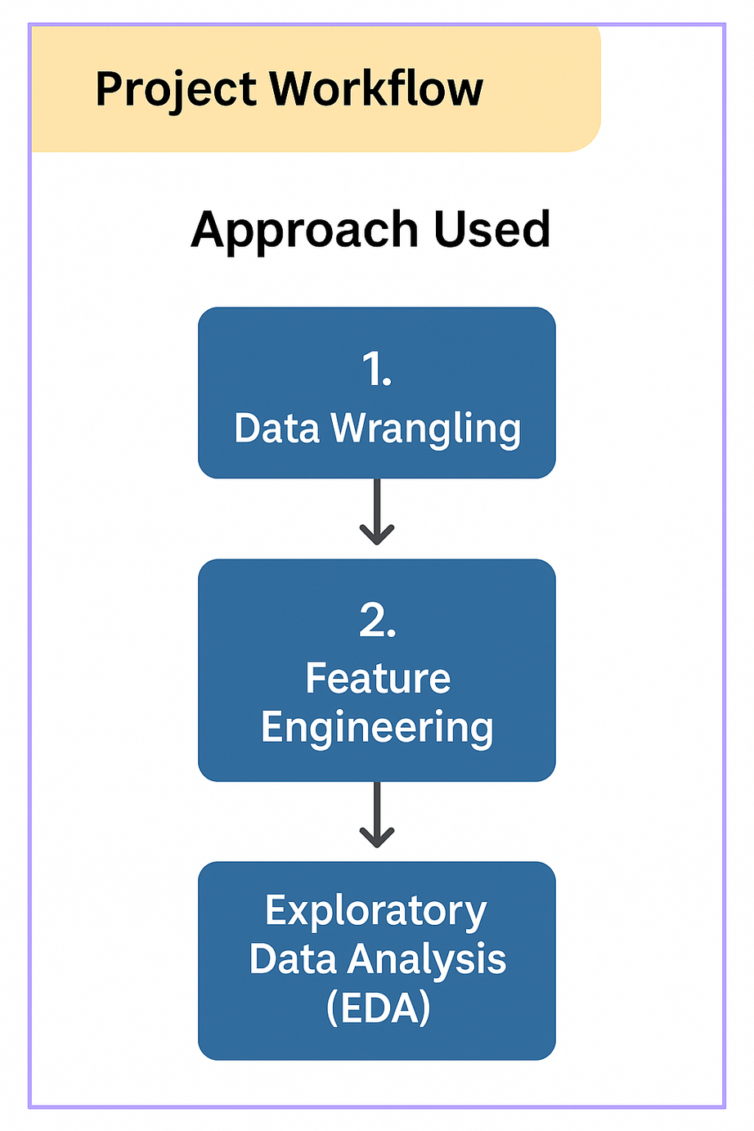
Project Workflow
1. Data Wrangling
2. Feature Engineering
3. Exploratory Data Analysis (EDA)

Slide 6
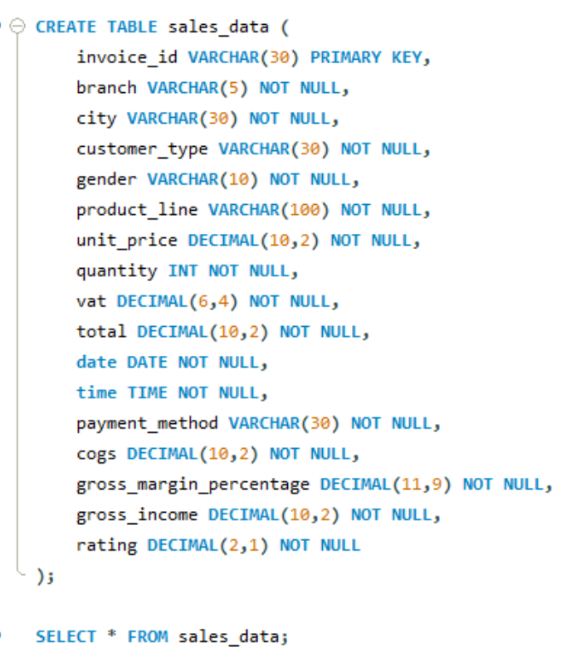
Data Wrangling
Created tables with NOT NULL constraints to ensure data completeness
Verified there are no NULL values
Data was cleaned and structured for accurate querying

Slide 7
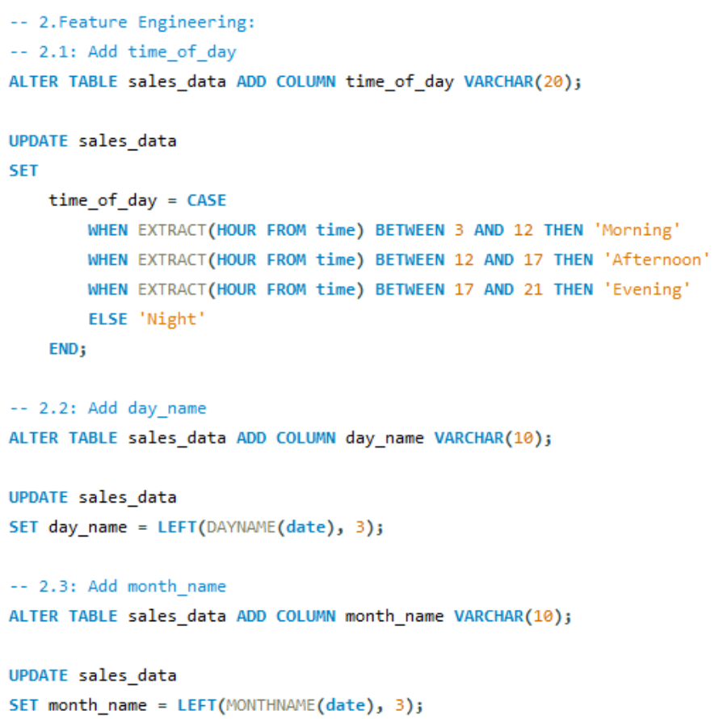
Feature Engineering
Added timeofday
→ Morning, Afternoon, Evening
Added dayname
→ Day of the week
Added monthname
→ Month of the transaction

Slide 8
Exploratory Data Analysis
28 business questions answered through SQL
Categories:
Product Performance
Customer Behavior
Sales Trends
VAT and Revenue Insights

Slide 9

Key Business Questions Answered
Which payment method occurs most frequently?
Which product line had the highest gross income?
Identify the time of day when customers provide the most ratings.
Which city generated the highest revenue?
Determine the day of the week with the highest average ratings for each branch.
Which product line incurred the highest Value Added Tax?

Slide 10
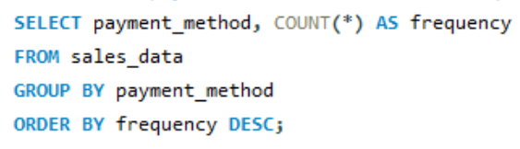
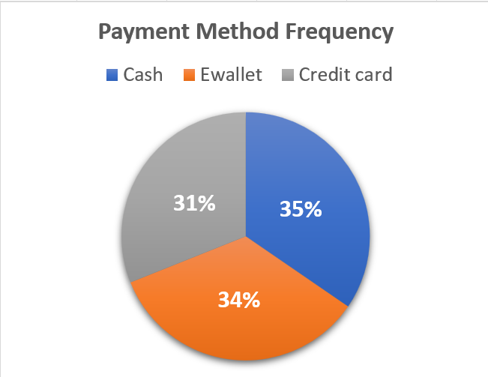
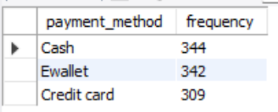
Which payment method occurs most frequently?

Slide 11
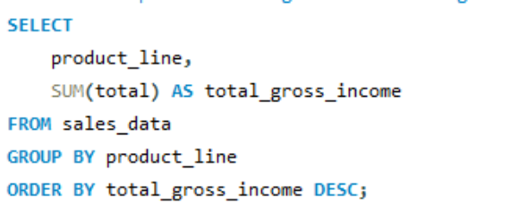
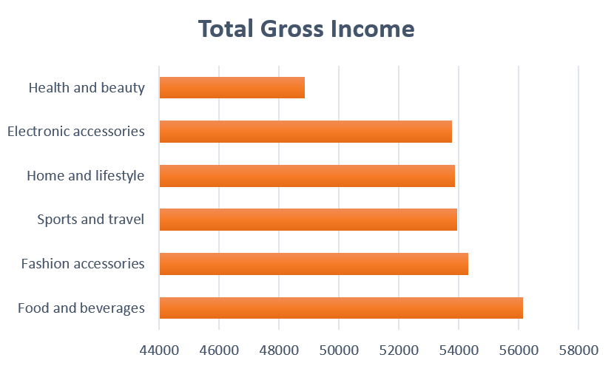
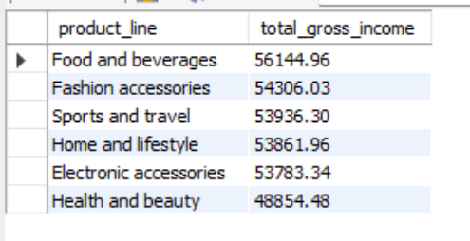
Which product line had the highest gross income?

Slide 12
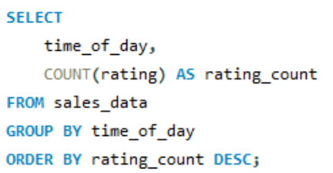
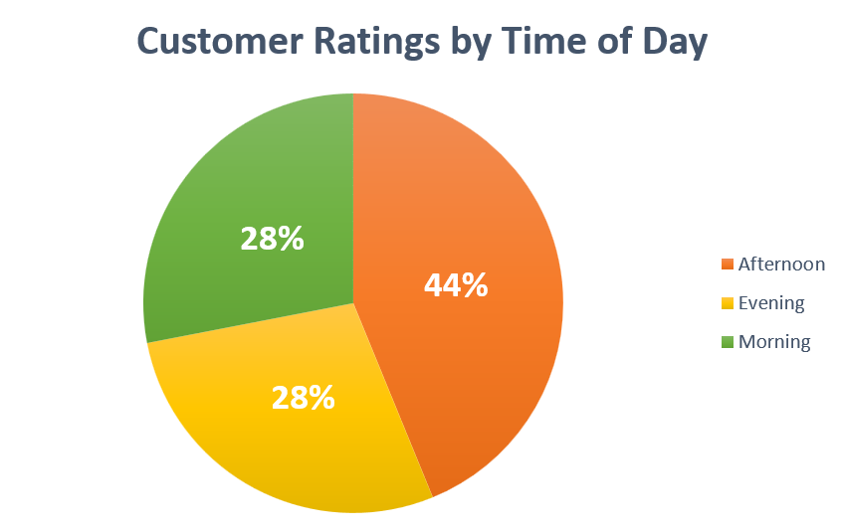
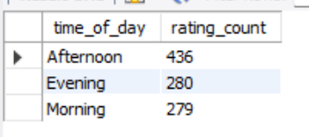
Identify the time of day when customers provide the most ratings.

Slide 13
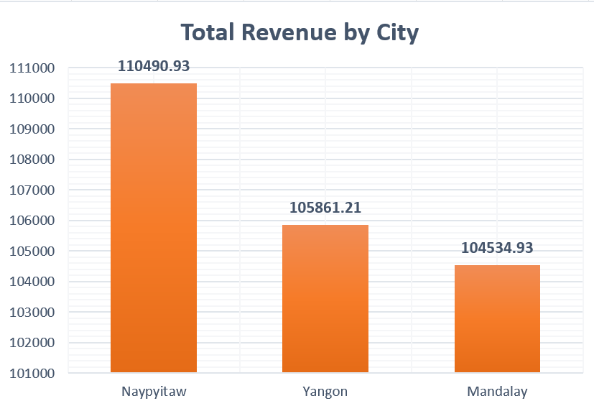
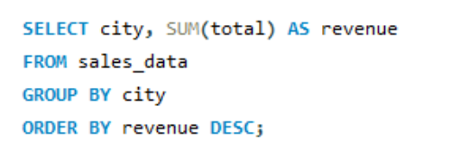
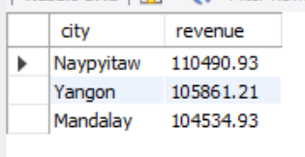
Which city generated the highest revenue?

Slide 14
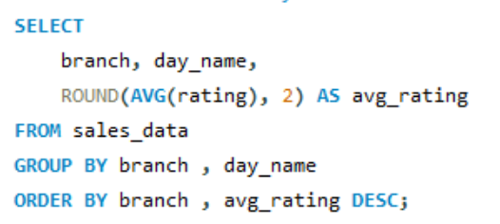
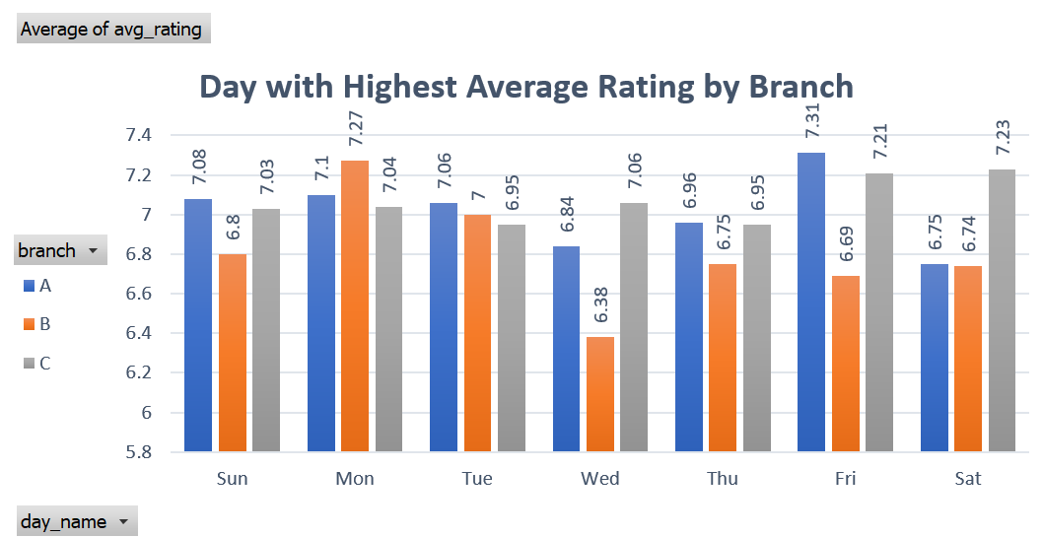
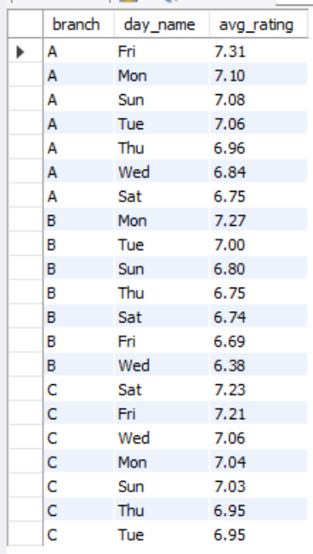
Determine the day of the week with the highest average ratings for each branch.

Slide 15
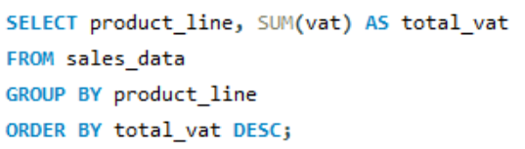
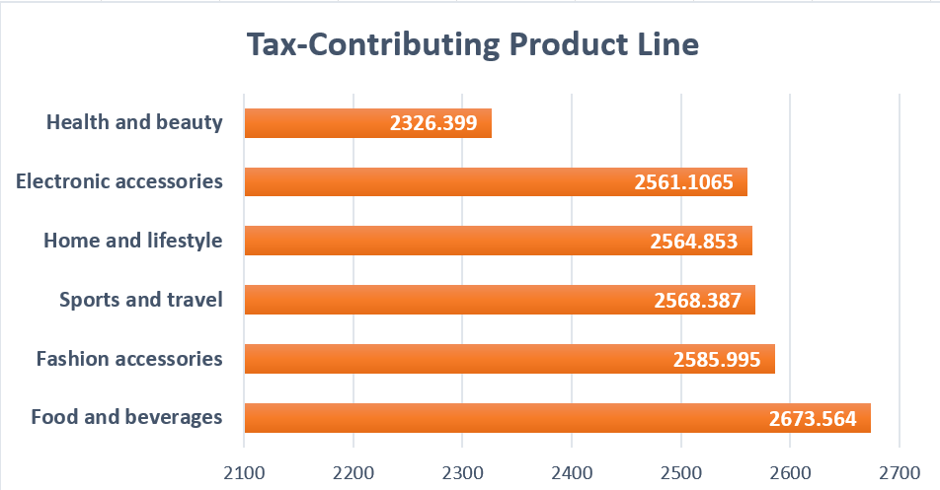
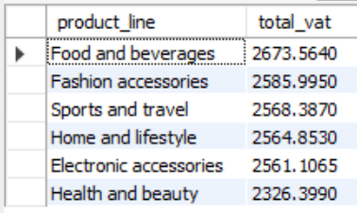
Which product line incurred the highest Value Added Tax?

Slide 16
Analysis Categories
📦 Product Analysis:
Identify top-performing and underperforming product lines
💰 Sales Analysis:
Track revenue, monthly trends, and sales peaks
👤 Customer Analysis:
Segment customer types and analyze buying behavior

Slide 17
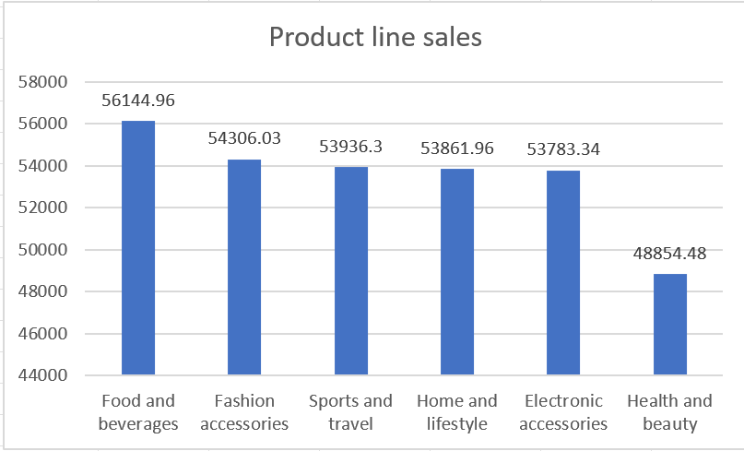
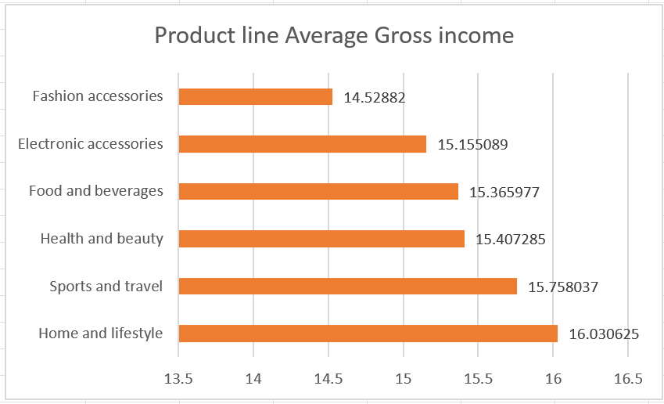
Product Analysis
Total sales by product line
Average gross income per product line:

Slide 18
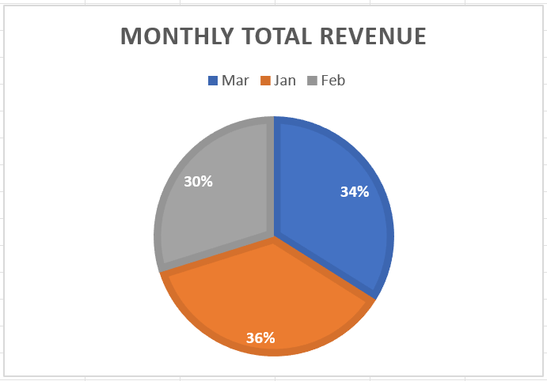
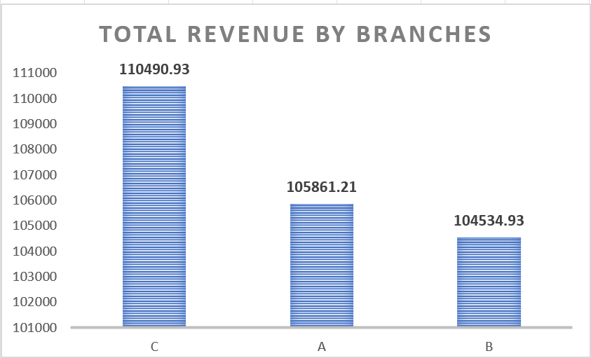
Sales Analysis
Highest revenue month
Branch with highest revenue

Slide 19
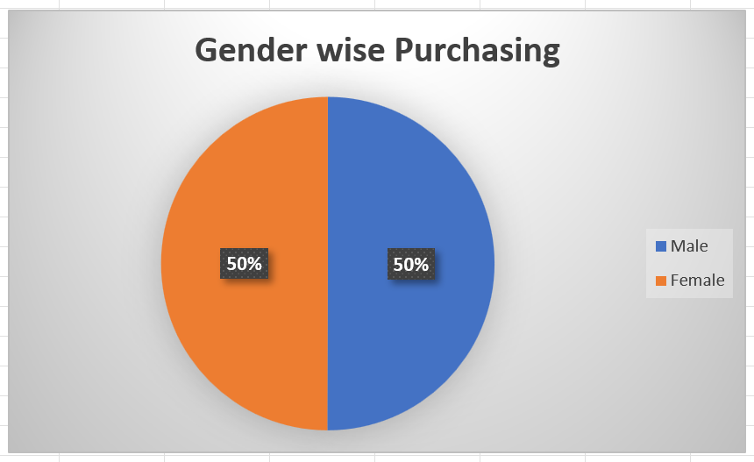
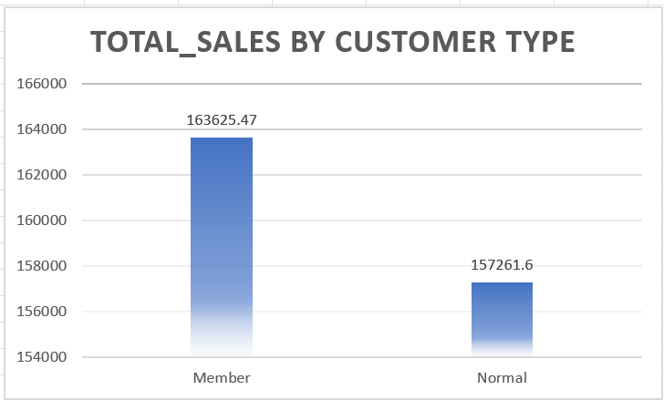
Customer Analysis
Gender-based purchasing trends
Top customer type by sales

Slide 20
Key Business Insights
Top Product Line: Health and Beauty
Highest Revenue: Generated in Naypyitaw
Peak Sales Time: Afternoon hours
Top Customer Type: Member customers
Rating Trend: Branches received the highest average customer ratings on Fridays

Slide 21
Business Recommendations
SQL helped answer real business questions efficiently:
Run promotions on Friday afternoons in Yangon.
Boost the inventory of ‘Health and Beauty’ items.
Focus more marketing on high-revenue branches and times.
Encourage feedback from customers during peak hours.
Expand successful product lines across all branches.

Slide 22


Tools Used
MySQL / SQL for queries
Excel for the dataset and visuals

Slide 23


